Slide 1

Final Project
Esra Aynali
March 2022

Slide 2
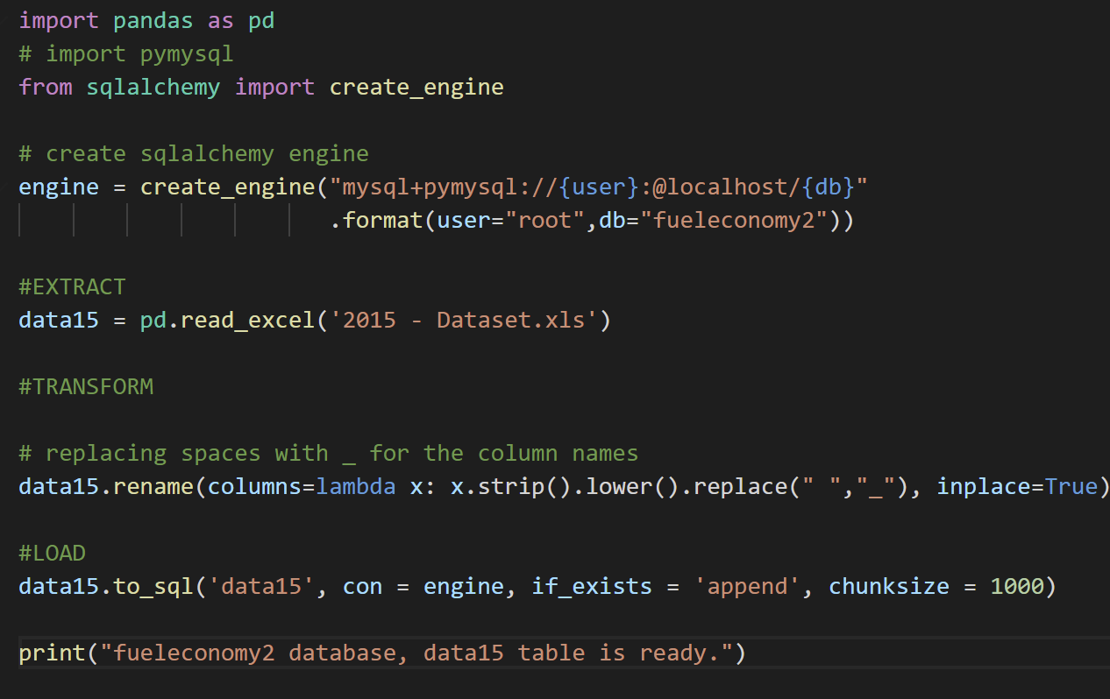
ETL operations
etl.py has the script for ETL
Extract: Getting data for 2015.
Transformation: Columns were renamed
Load: Data was loaded into the data15 table in fueleconomy database

Slide 3
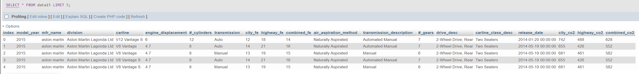
Loaded Data

Slide 4
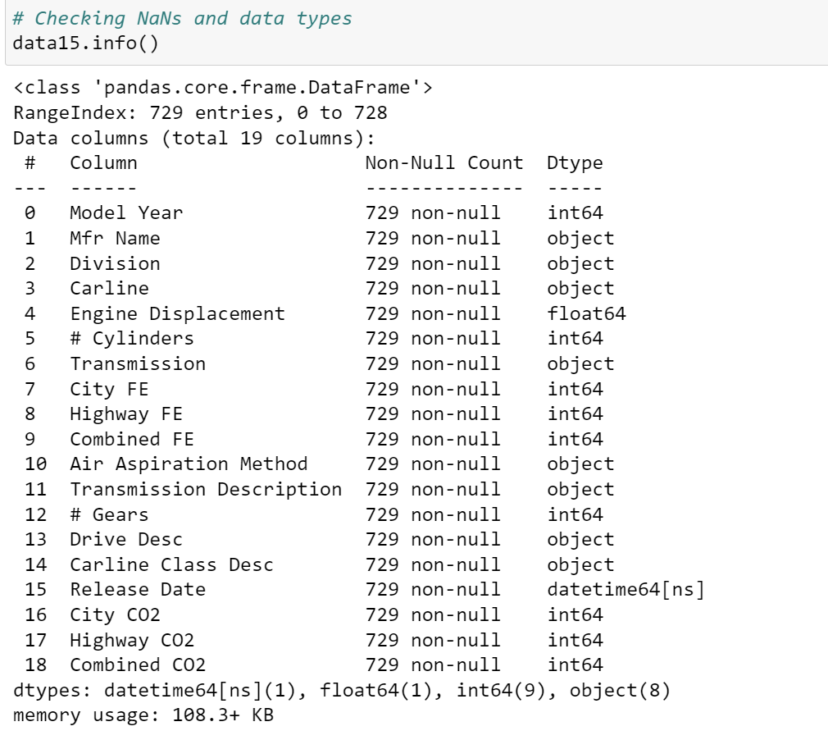
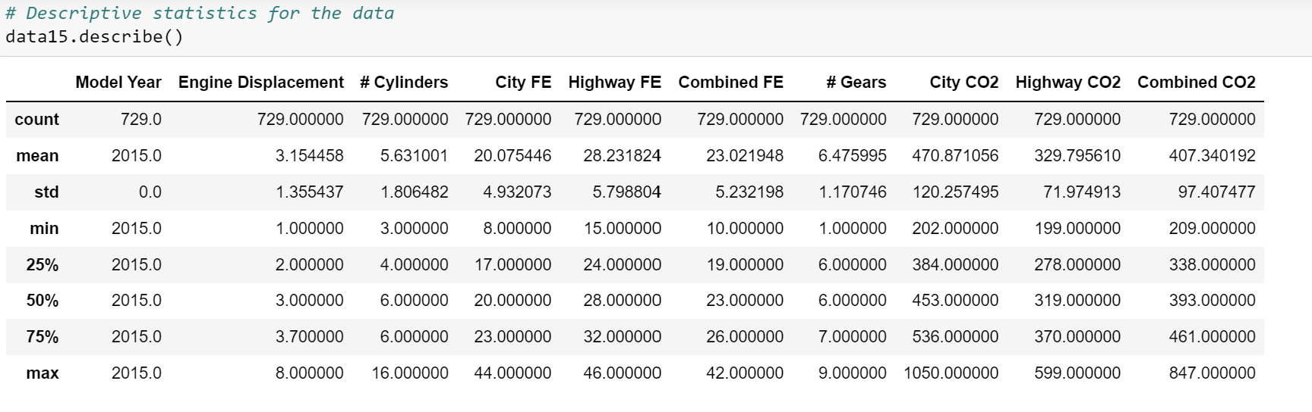
Data exploration for 2015

Slide 5
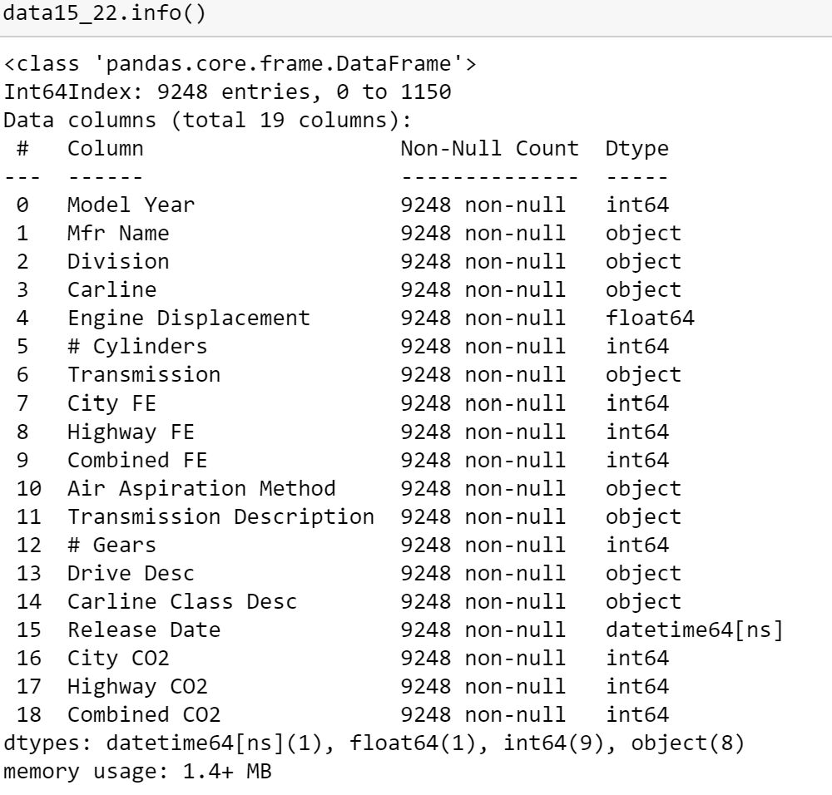
Data exploration (2015-2022)

Slide 6
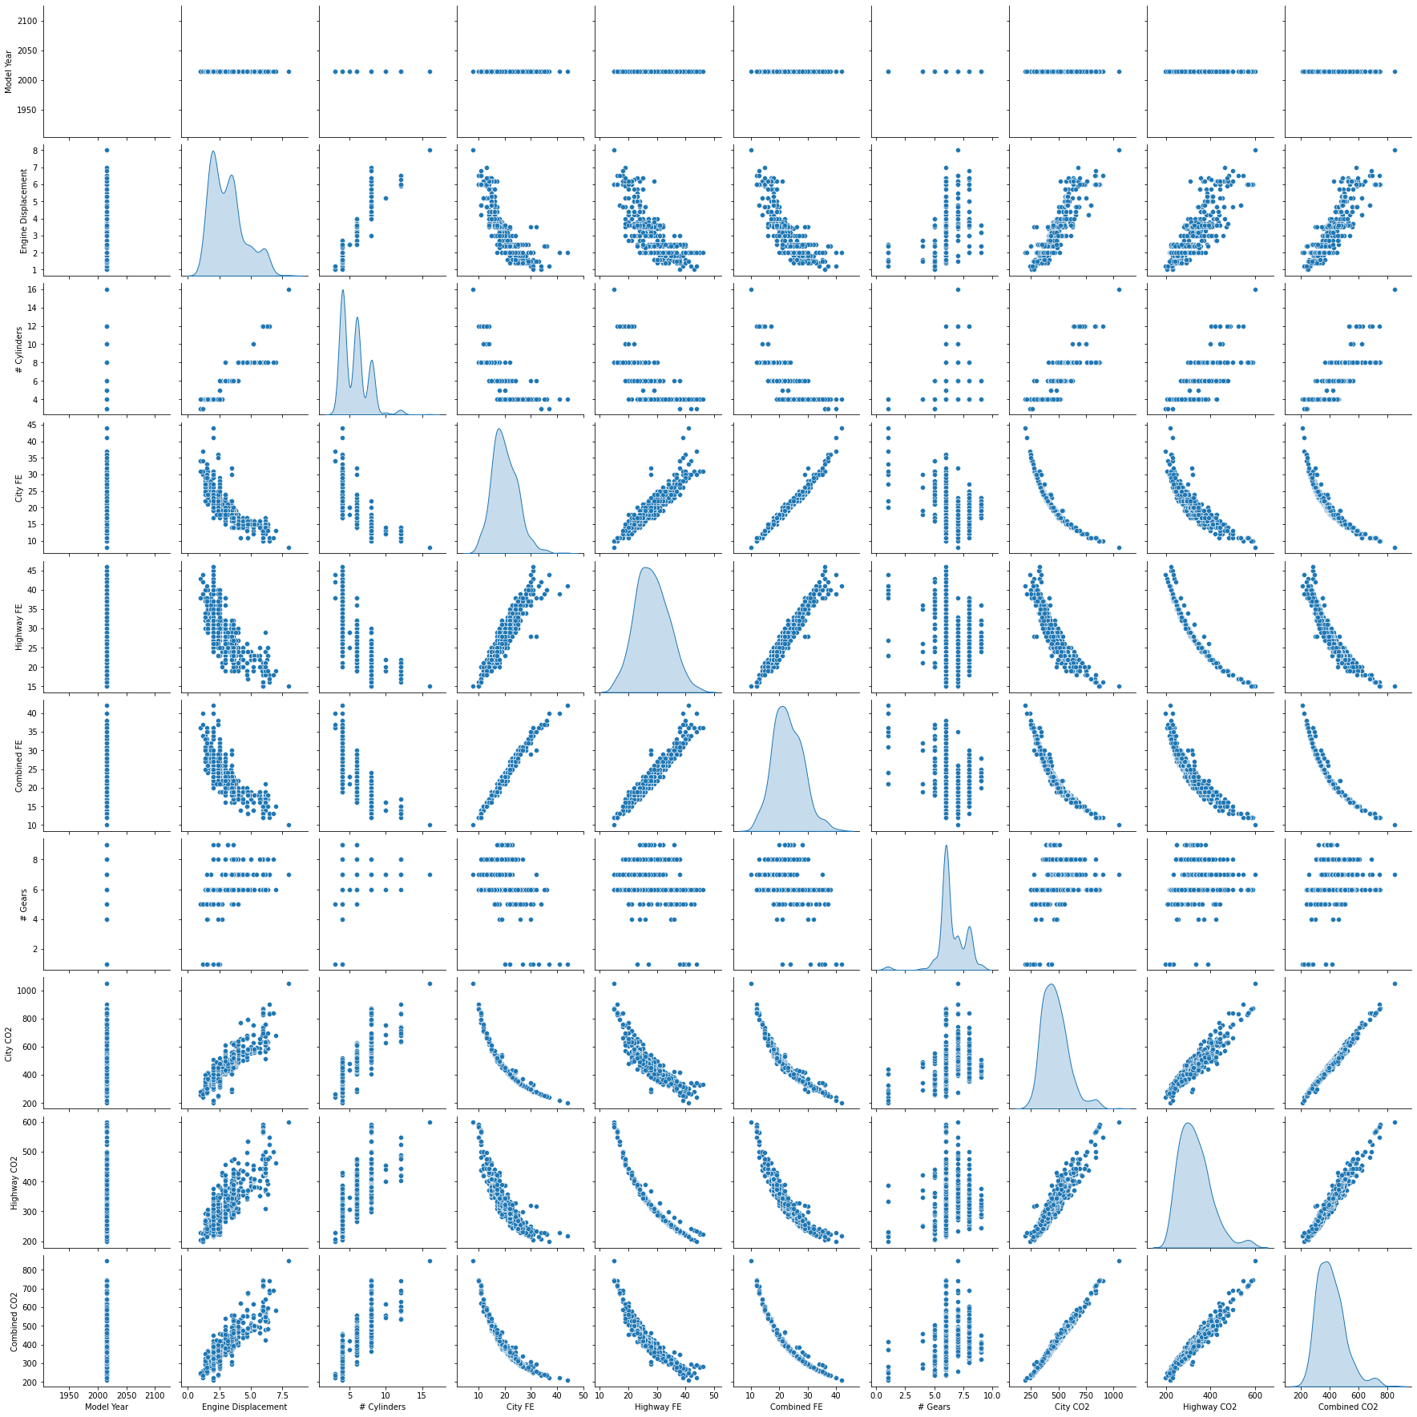
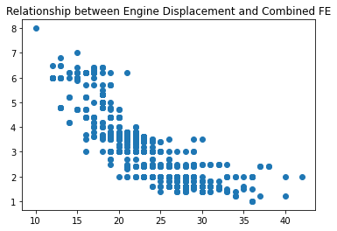
Data exploration
Pairwise Relationships in the dataset

Slide 7
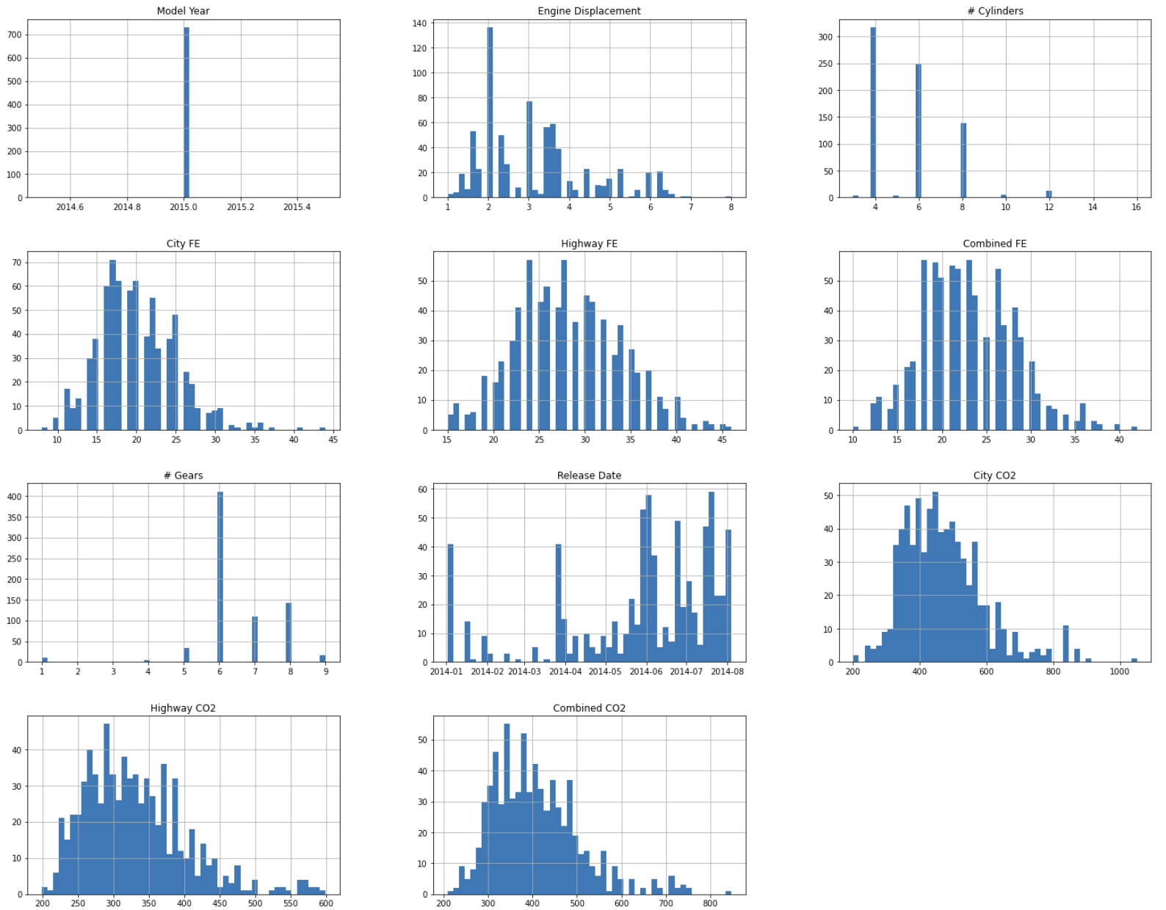
Data exploration
Distributions for each attribute
Notes:
Distributions for each attribute

Slide 8
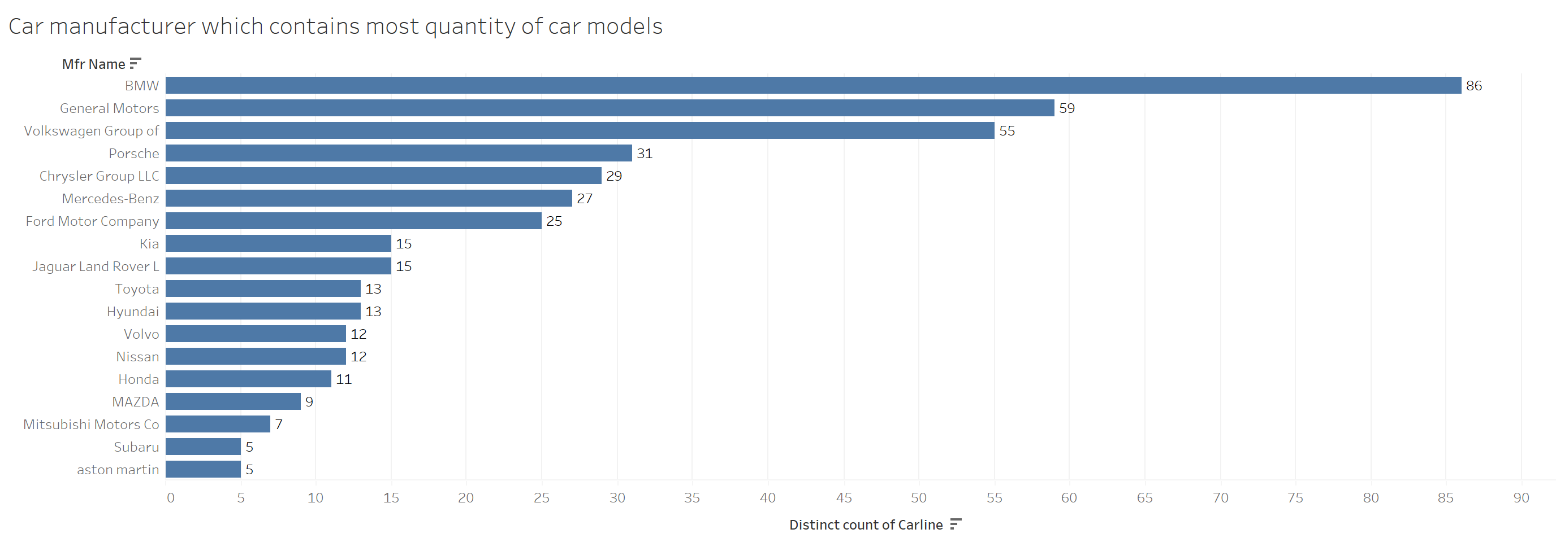
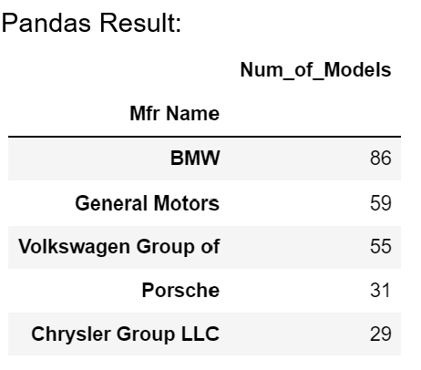
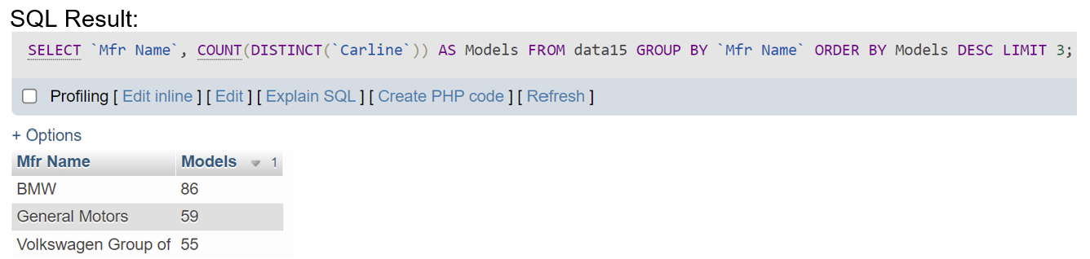
Question 1
Find the car manufacturer, which contains most quantity of car models

Slide 9
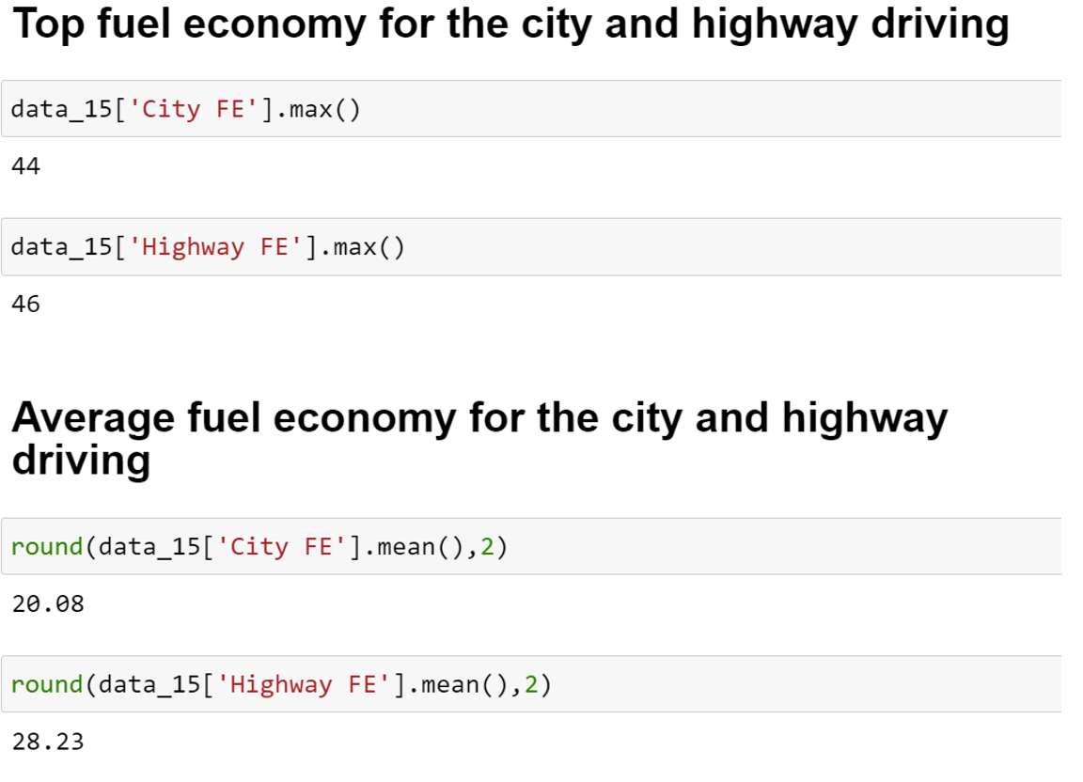
Question 2
Find the top average fuel economy for the city and highway driving from the given data set.

Slide 10
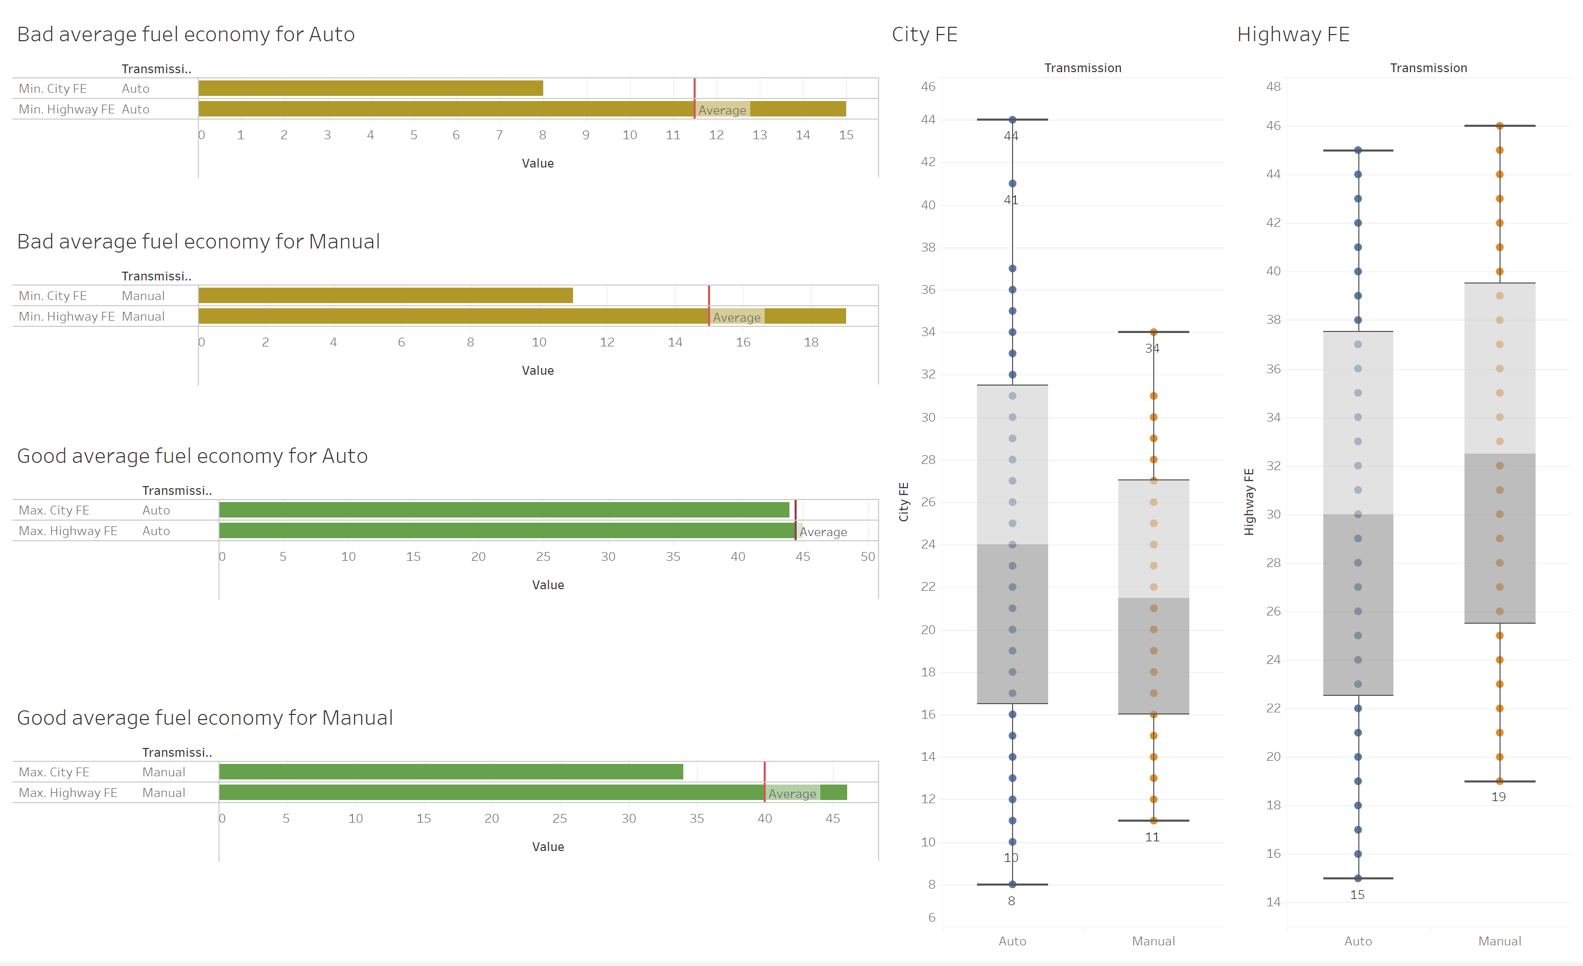
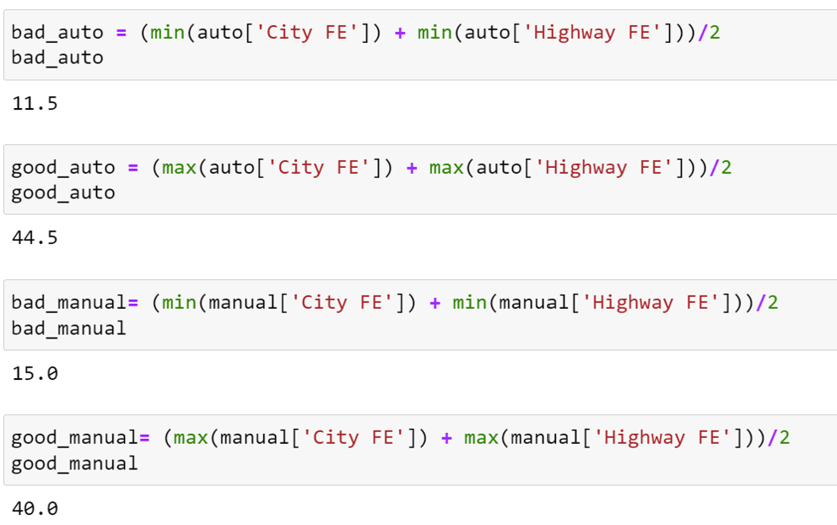
Question 3
Find good and bad average fuel economy from all transmission types

Slide 11
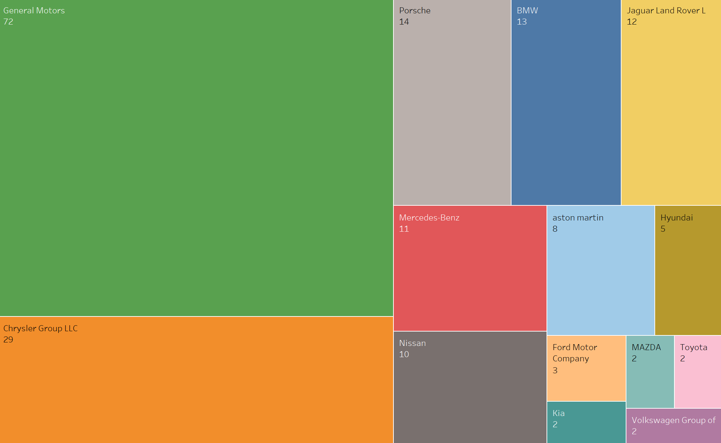
Question 4
Find car manufacturers, which have 4WD (4-wheel drive) and 2WD (2-wheel drive) with engine power is more than 3.5.

Slide 12
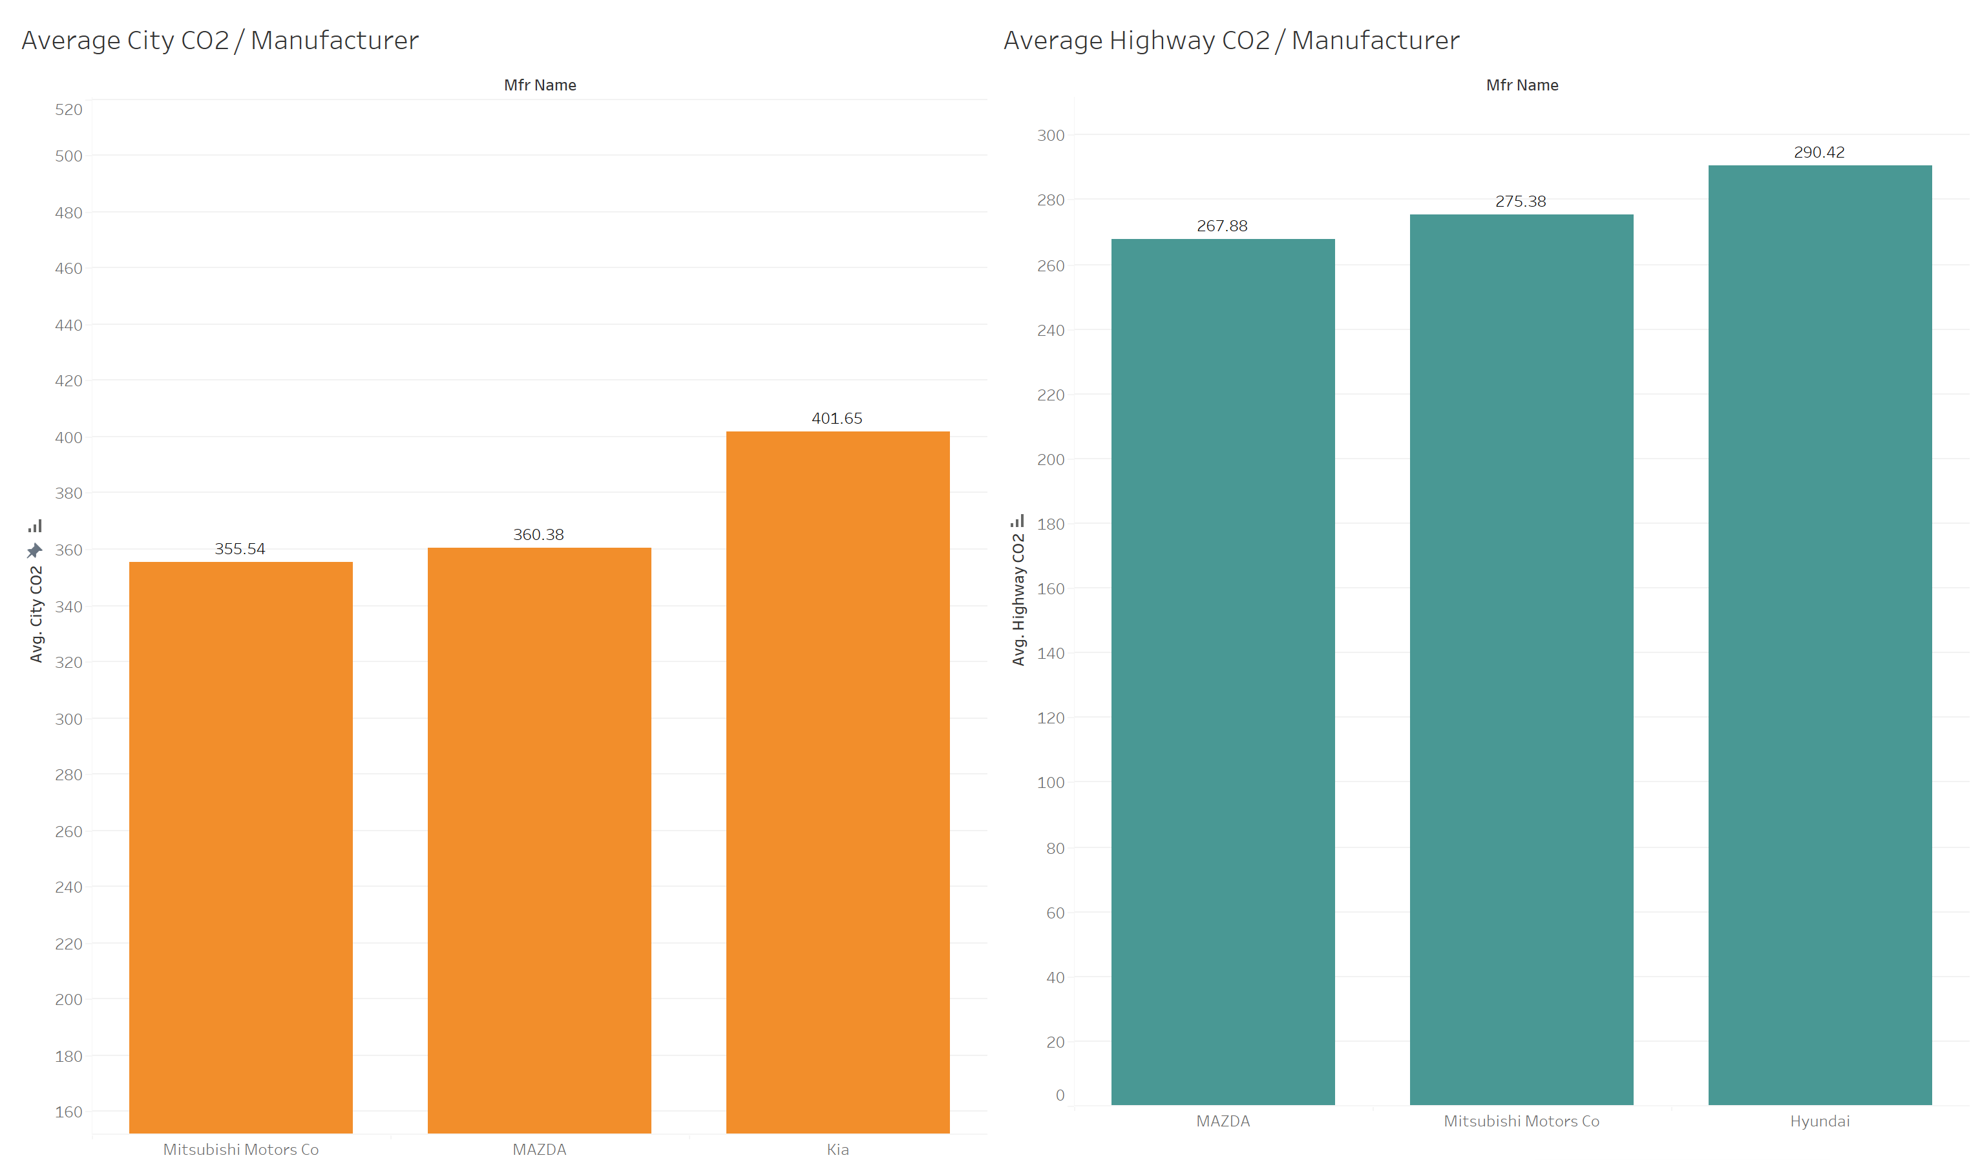
Question 5
Top 3 car manufacturer that have the lowest average CO2 for city and highway for 2015?

Slide 13
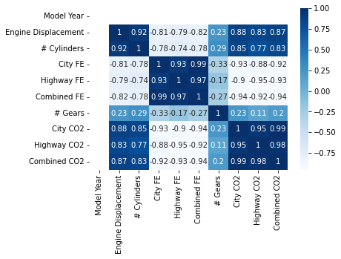
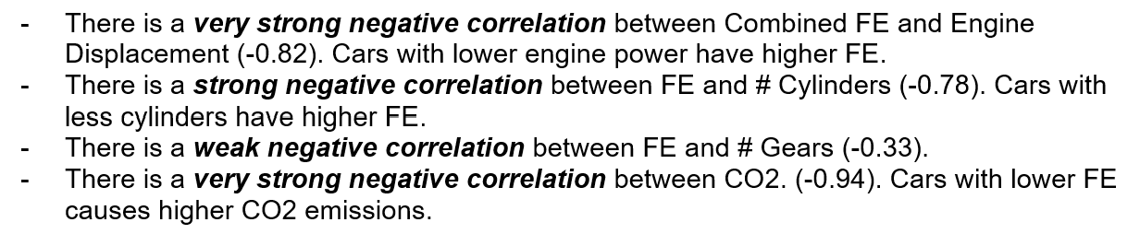
Question 6
Which features are correlated with FE?

Slide 14
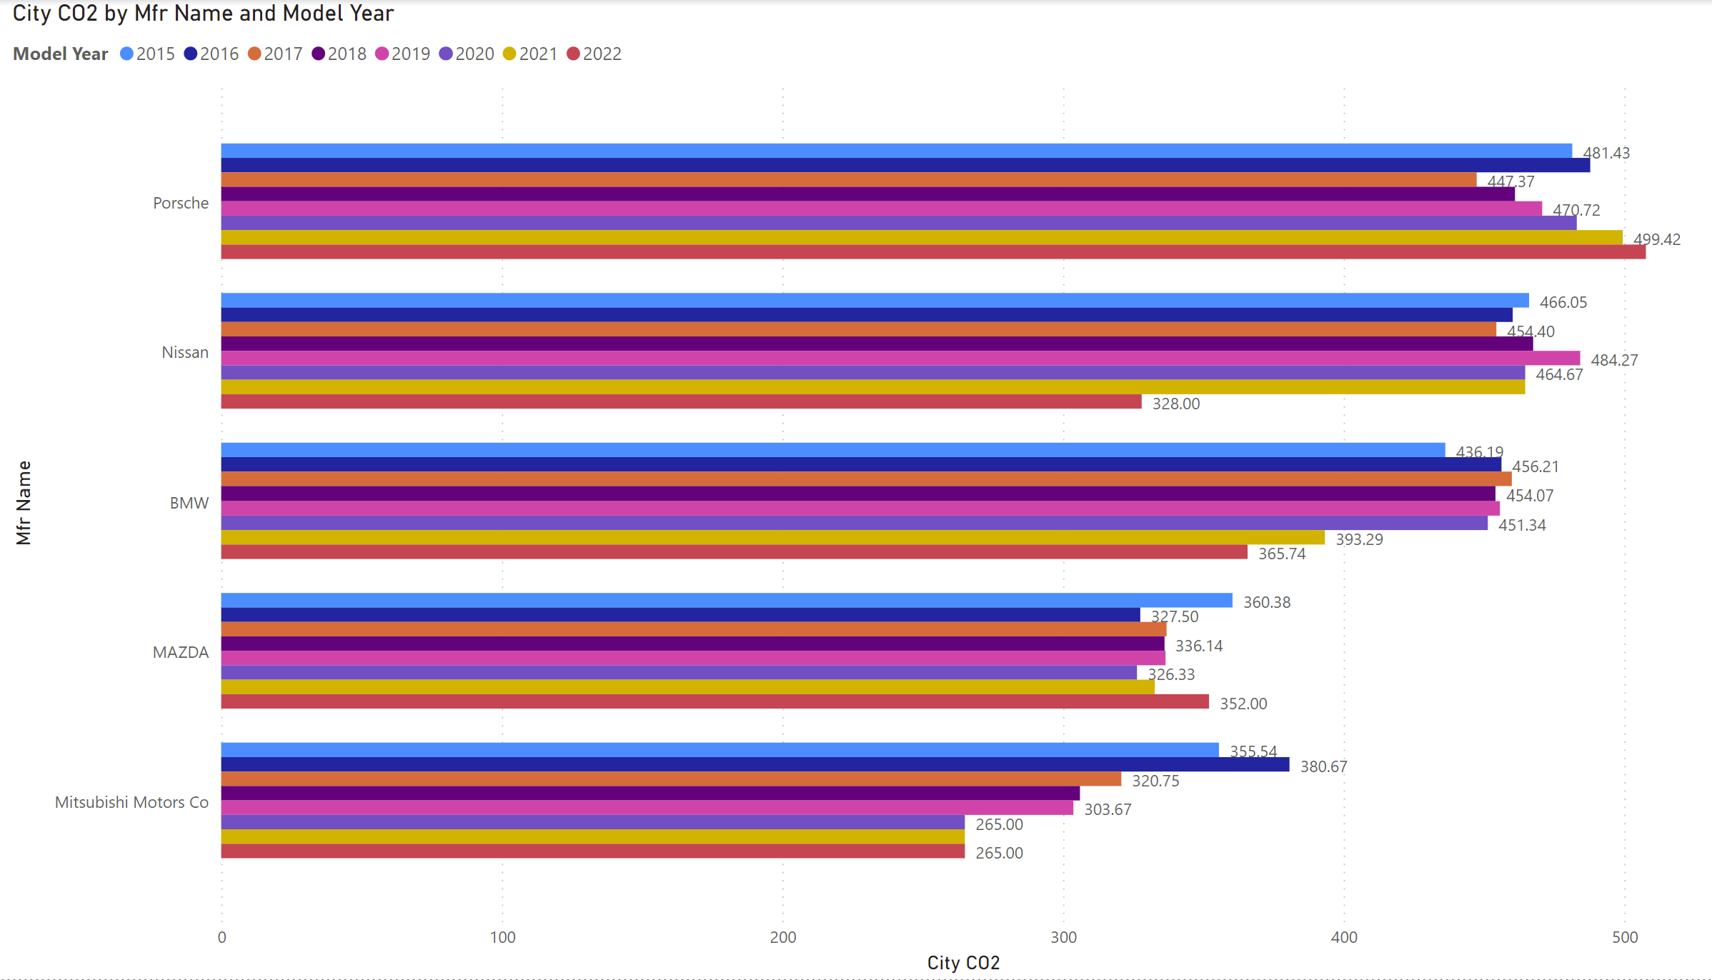
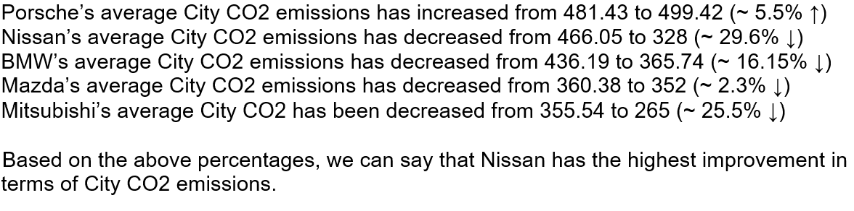
Question 7
How has the city CO2 changed from 2015 to 2022 for the manufacturers which has records for all years (grams per mile)?

Slide 15
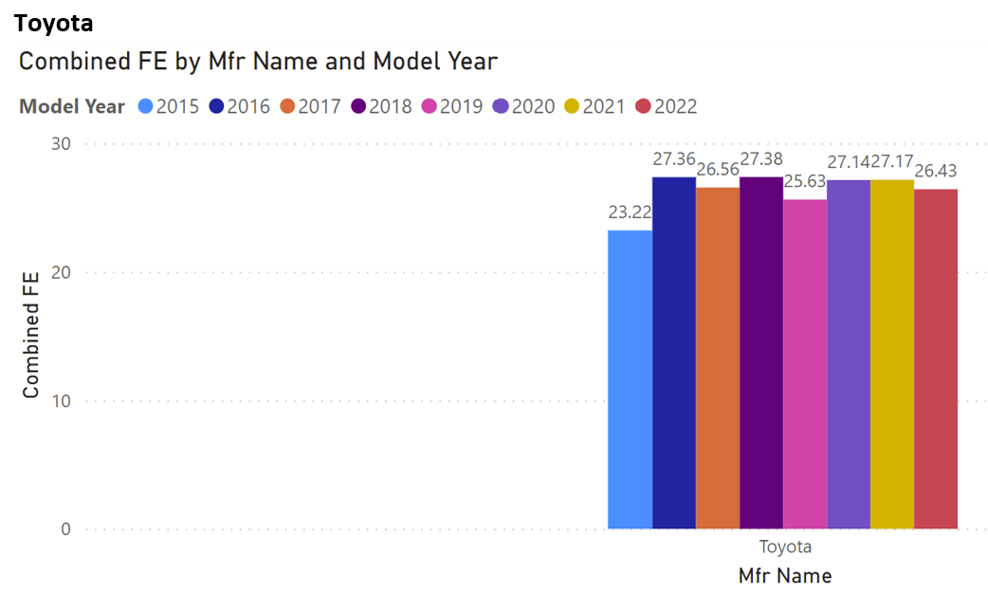
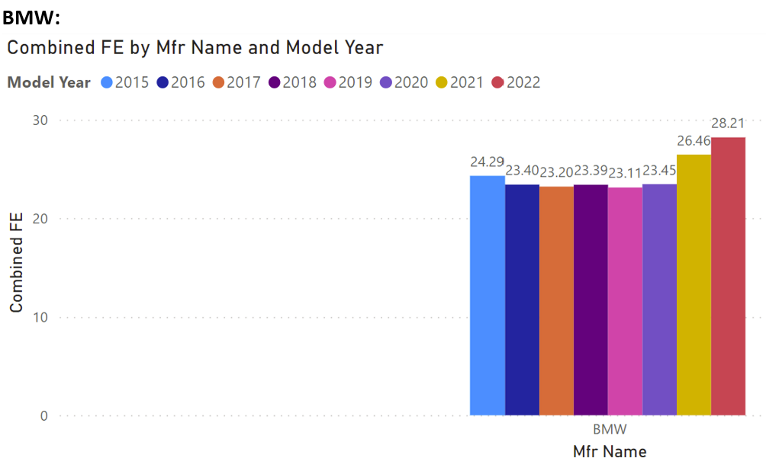
Question 8
How has the average Combined FE changed from 2015 to 2022 for Toyota and BMW?

Slide 16
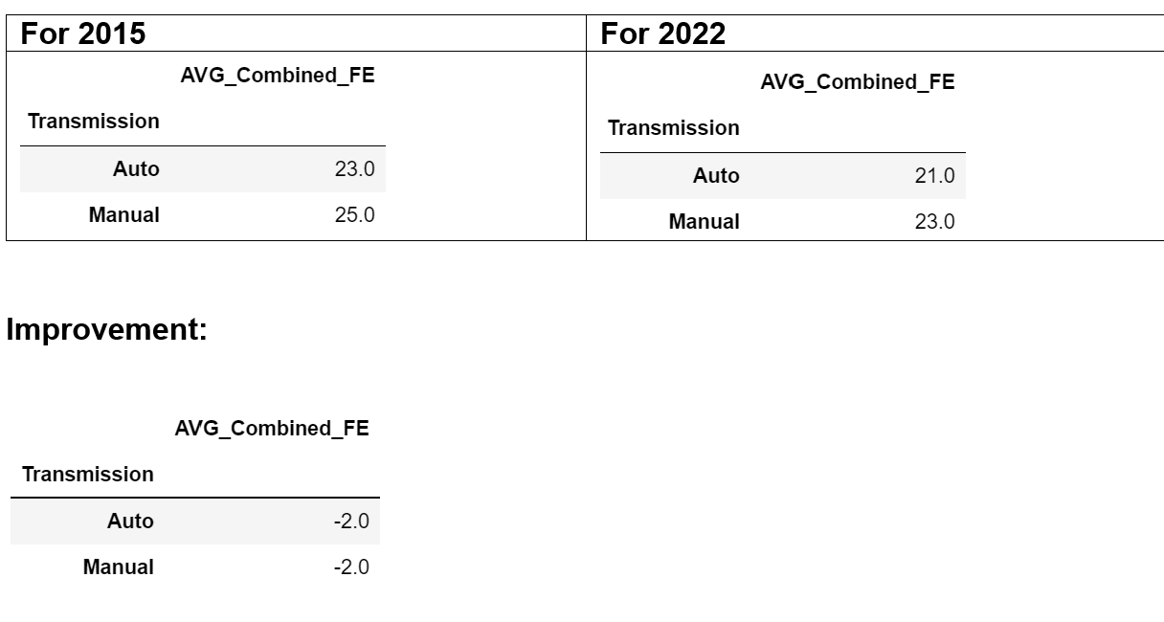
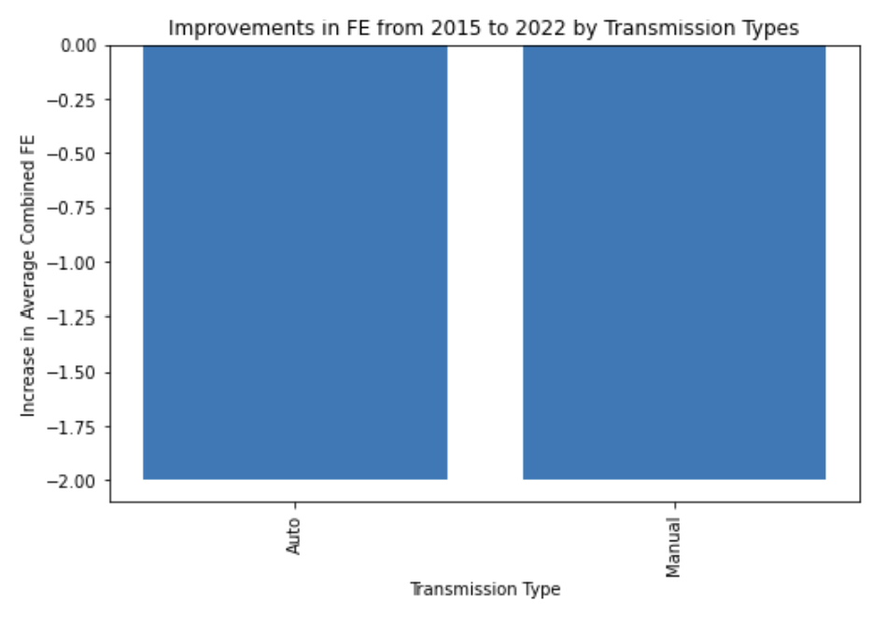
Question 9
How much has the combined FE improved in transmission types?

Slide 17
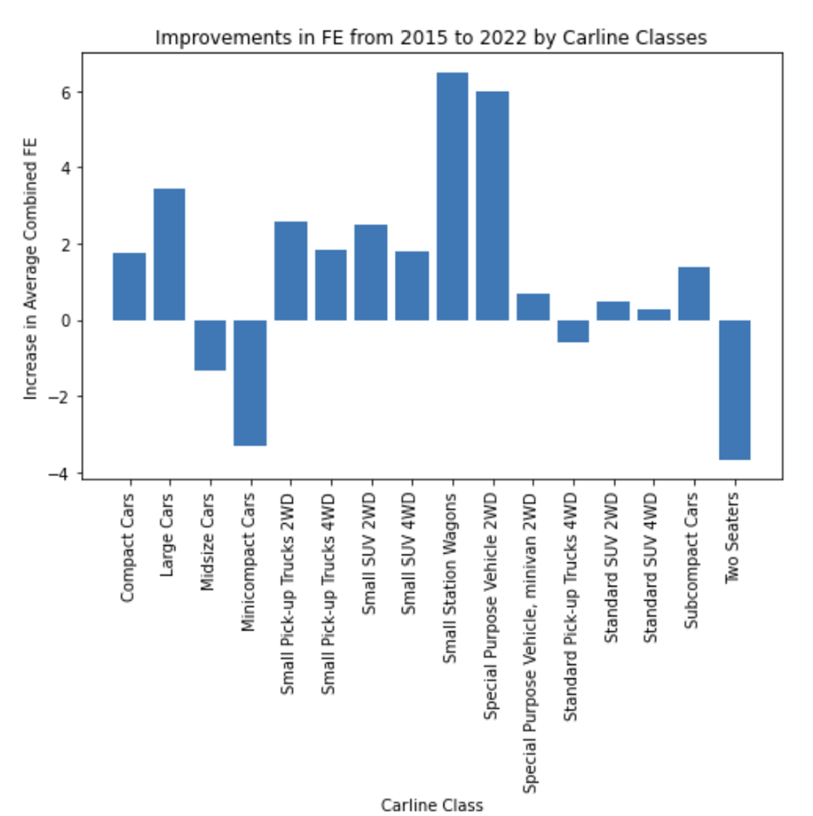
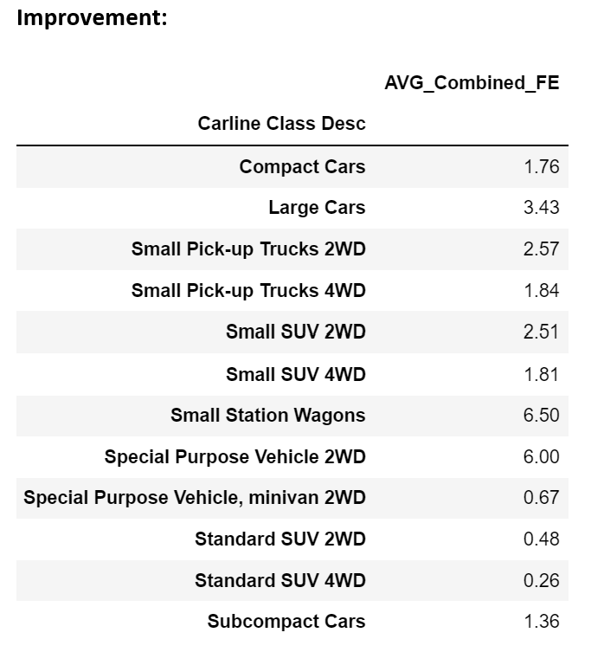
Question 10
How much has the combined FE improved in carline classes?

Slide 18
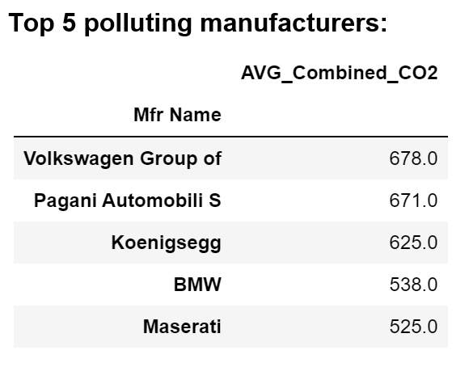
Question 11
For the years between 2015 to 2022, which manufacturer has the most polluting cars? (SMOG Rating=1)

Slide 19
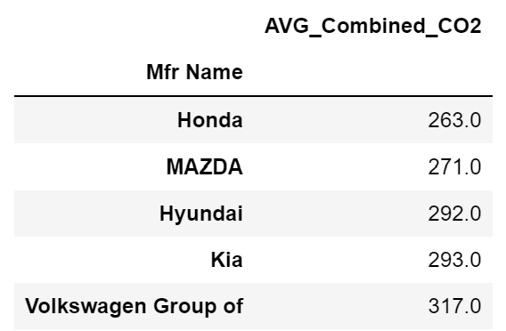
Question 12
For the years between 2015 to 2022, which manufacturer is the cleanest? (SMOG Rating=9)

